Slide 1
Exploratory Data Analysis

Slide 2
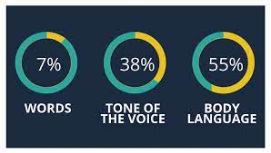
Data Visualization and Insights
Data Visualization : Visual analytics is the representation and presentation of data that exploits our visual perception abilities in order to amplify cognition
Insights : Insight is the discovery of non-trivial, complex, deep, unexpected, or relevant truths about the information
7% – 38% – 55% rule
7% of the message is conveyed by the words
they use
38% is conveyed by tone of voice
55% by body language or facial expression
Notes:
Data visualization is the graphical display of abstract information for two purposes: sense-making (also called data analysis) and communication. Important stories live in our data and data visualization is a powerful means to discover and understand these stories, and then to present them to others
How to get your Customer understand what you want to convey ?

Slide 3
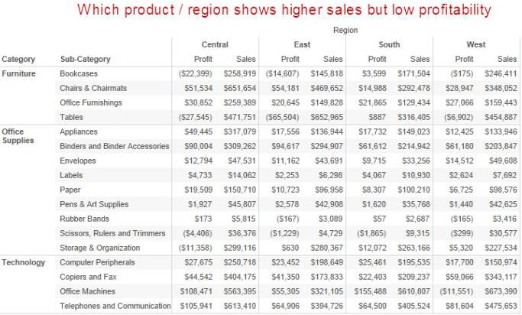
Importance of Data Visualization
Which product has the highest sales?
Highest Sales but less Profit ?
Less Sales but more profit % ?
Notes:
Profit and Sales by Category & Sub-Category. Distributed by Regions
Negative values are enclosed by bracket
Which area has more sales?
Less sales?
More sales but less profit?
Less sales but more profit ?

Slide 4
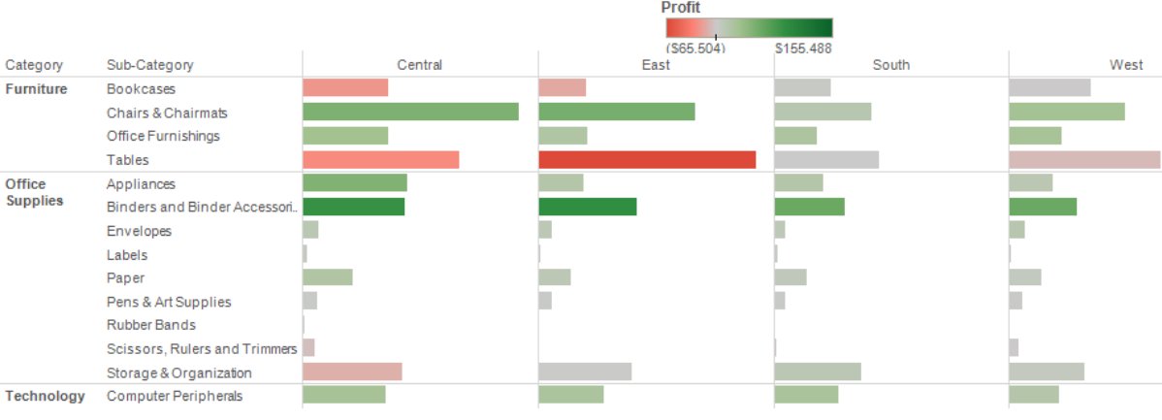
Importance of Data Visualization
Recommendations to Client
Notes:
Even Sale is same but profit is negative so I can make my procurements accordingly to escape the loss

Slide 5
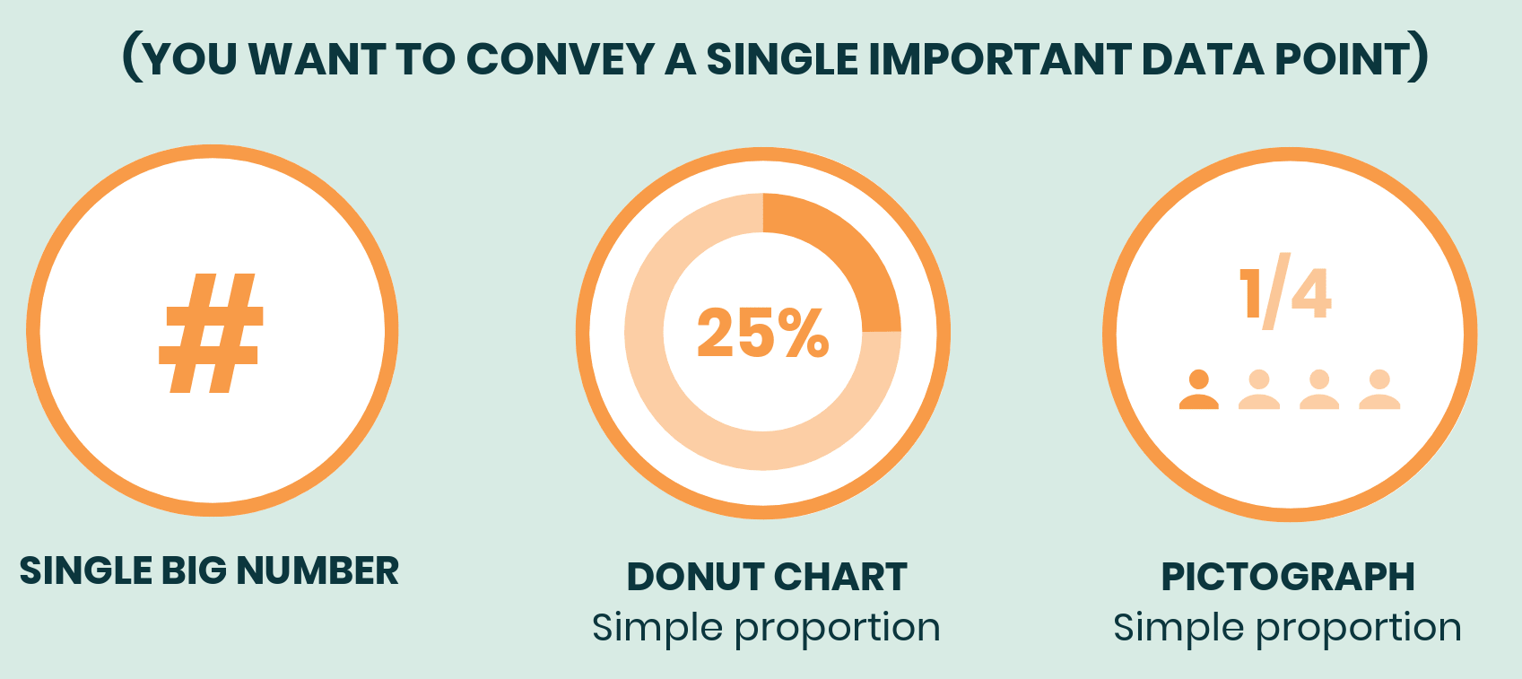
Choosing Charts based on Business Purpose
Display Single Figure
Notes:
https://venngage.com/blog/how-to-choose-the-best-charts-for-your-infographic/

Slide 6
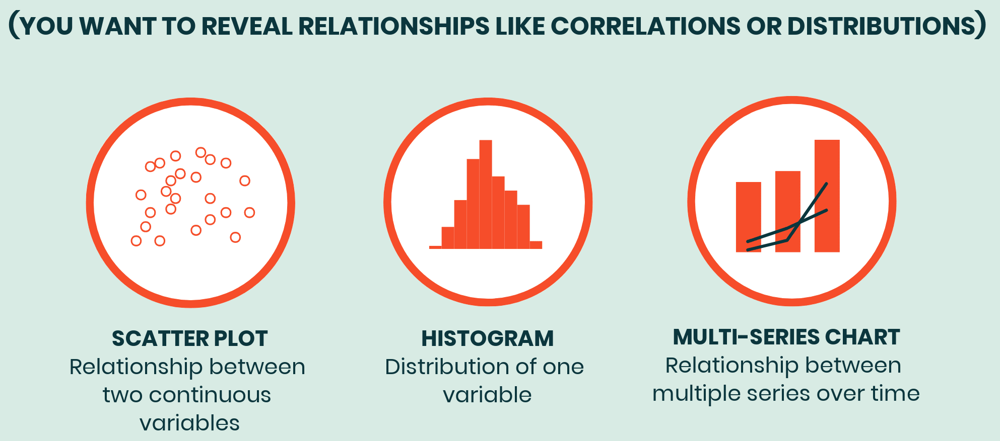
Choosing Charts based on Business Purpose
Relationship
Notes:
https://venngage.com/blog/how-to-choose-the-best-charts-for-your-infographic/

Slide 7
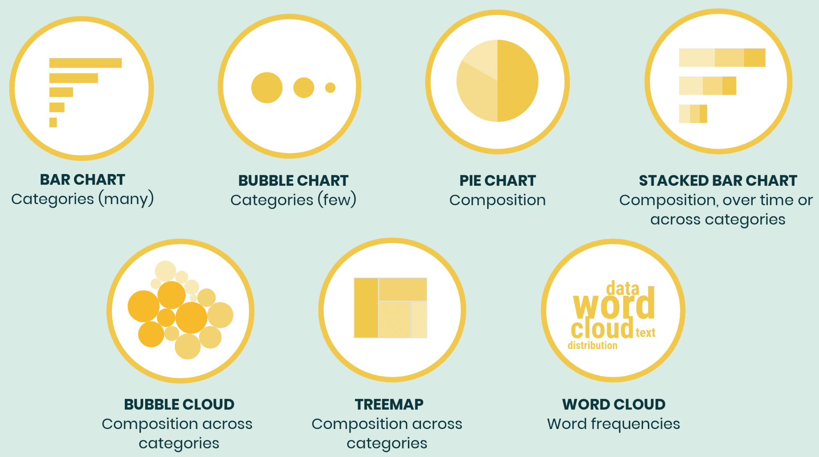
Choosing Charts based on Business Purpose
Compare
Notes:
https://venngage.com/blog/how-to-choose-the-best-charts-for-your-infographic/
Like the scatter plot, a bubble chart is primarily used to depict and show relationships between numeric variables. However, the addition of marker size as a dimension allows for the comparison between three variables rather than just two.
A pie chart is best used when trying to work out the composition of something. If you have categorical data then using a pie chart would work really well as each slice can represent a different category.
A stacked bar graph (or stacked bar chart) is a chart that uses bars to show comparisons between categories of data, but with ability to break down and compare parts of a whole. ... Stacked Bar graph can be used to represent: Ranking, Nominal Comparisons, Part-to-whole, Deviation, or Distribution
A bubble chart is a data visualization that displays multiple circles (bubbles) in a two-dimensional plot. It is a generalization of the scatter plot, replacing the dots with bubbles. Most commonly, a bubble chart displays the values of three numeric variables, where each observation data is shown by a circle ("bubble"), while the horizontal and vertical positions of the bubble show the values of two other variables.
Tree Maps are primarily used to display data that is grouped and nested in a hierarchical (or tree-based) structure. Example: There are approx. 10-15 major categories of cause of death – Circulatory System Diseases, Cancers, Respiratory Diseases, External Causes of Mortality etc.

Slide 8
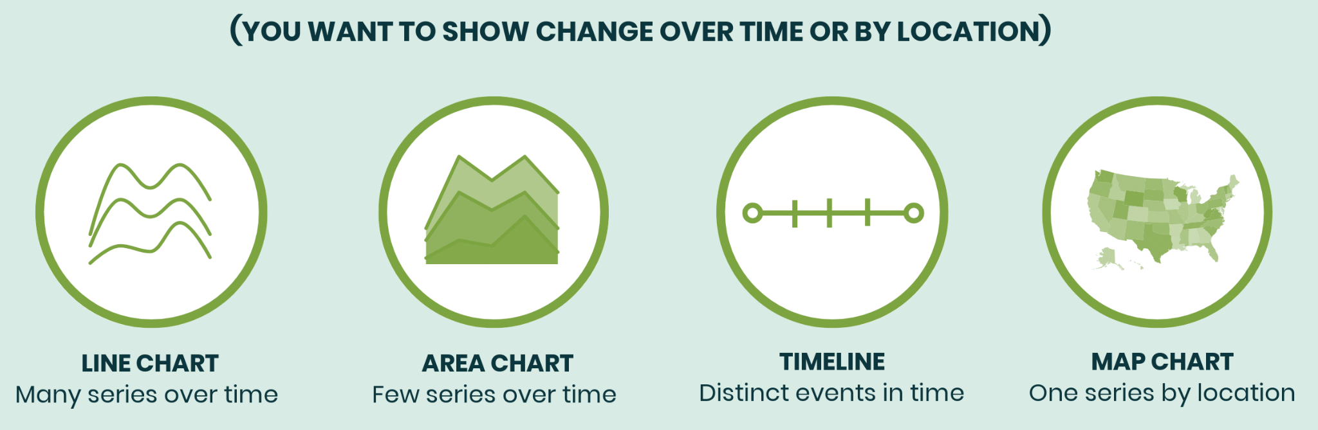
Choosing Charts based on Business Purpose
Notes:
https://venngage.com/blog/how-to-choose-the-best-charts-for-your-infographic/
Garbage in, garbage out, right?
Instead, start by defining a single visualization goal for your chart. That goal should line up with one of our ICCOR categories, either to:
Inform: convey a single important message or data point that doesn’t require much context to understand
Compare: show similarities or differences among values or parts of a whole
Show Change: visualize trends over time or space
Organize: show groups, patterns, rank or order
Reveal Relationships: show correlations among variables or values

Slide 9
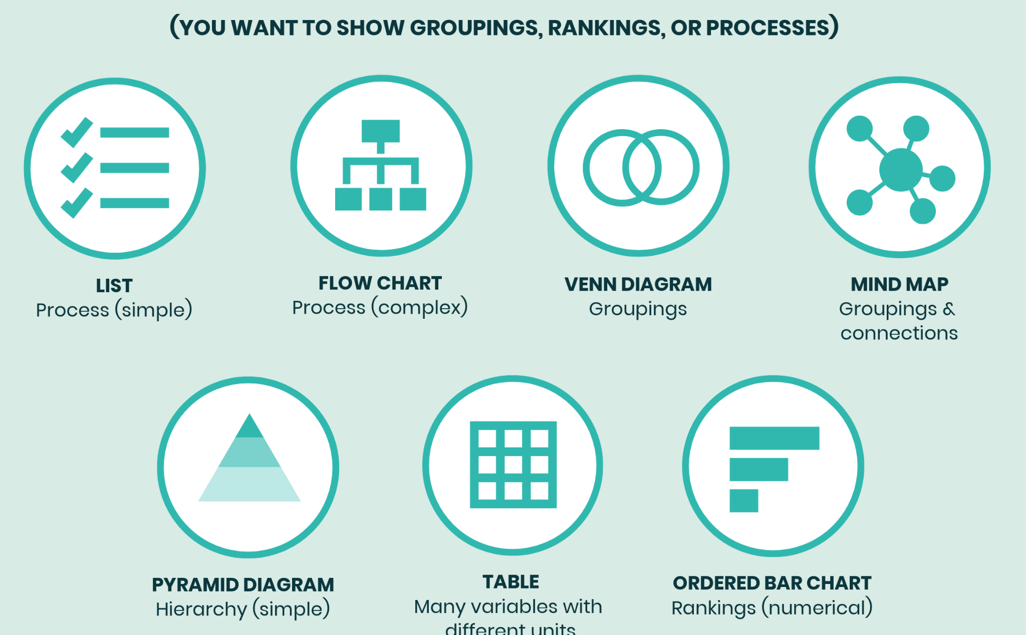
Choosing Charts based on Business Purpose
Two Steps Process
Determine your visualization goal
Choose the best chart to achieve that goal
Notes:
https://venngage.com/blog/how-to-choose-the-best-charts-for-your-infographic/

Slide 10
Measures and Dimensions
Measures | Dimensions
Numerical | Categorical
Quantitative | Qualitative
Values that mathematical functions work on | Dimension is what you “slice and dice” the number by.
E.g. sales , revenue, income, population, cost | E.g. Departments, country, Gender, Type of products

Slide 11
Choosing Charts based on Data Type
One Measure + One Dimension
One Measure + One Measure
One Measure
Date + 1 Measure
Distribution –2 Measures + 1 Dimension(Tree Map)

Slide 12
Choosing Charts based on Data Type
One Measure + One Dimension
Business Stories :
Compare (High / Low)
Rank (Organize)
Part to Whole
Common Plots :
Bar Plot
Heat Map (Distribution)

Slide 13
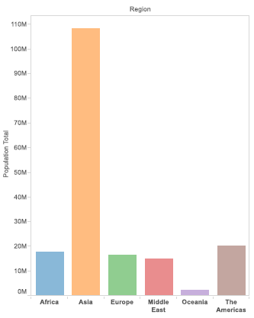
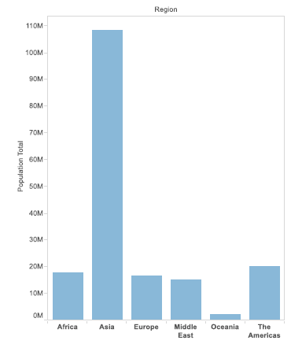
Bar Plot
Notes:
This is vertical bar graph,
Use when you have one categorical variable and one numerical variable.
This gives a visual clue of population distribution by region.
These are two bar

Slide 14
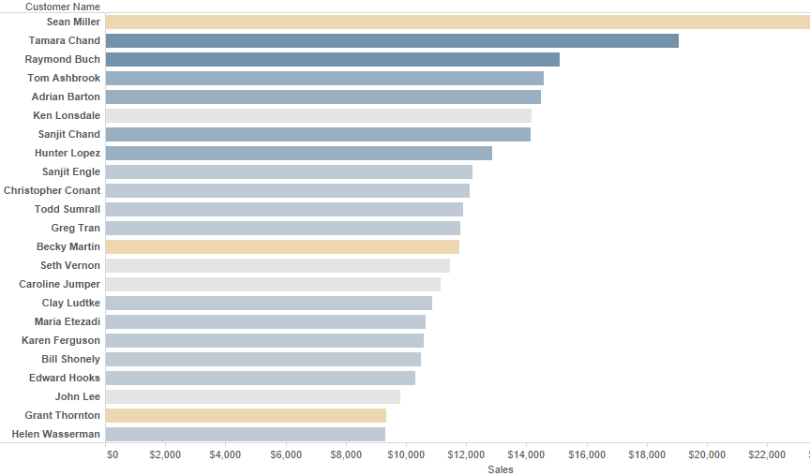
Bar Plot

Slide 15
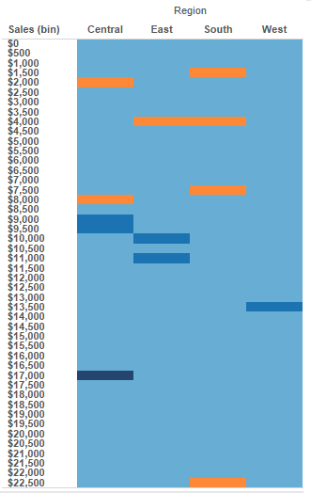

Heat Plot

Slide 16
Choosing Charts based on Data Type
One Measure + One Measure
Business Stories :
Trend
Concentrations
Gaps
Outliers
Groups/Clusters
Relationship
Common Plots :
Scatter Plot

Slide 17
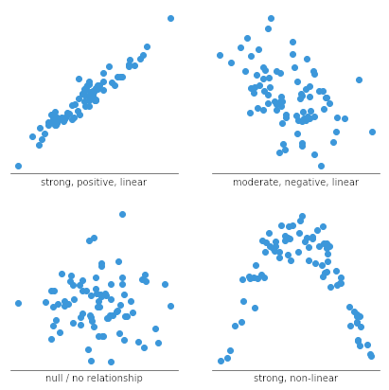
Scatter Plot - Snapshot of Different Relationships
Notes:
Illustrate How we can make judgements of relationships between two numerical variables
Look at the trend: Illustrate with axis

Slide 18
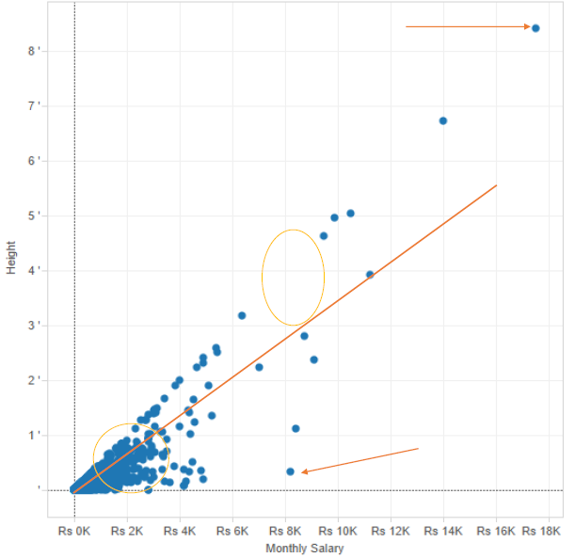
Scatter plot

Slide 19
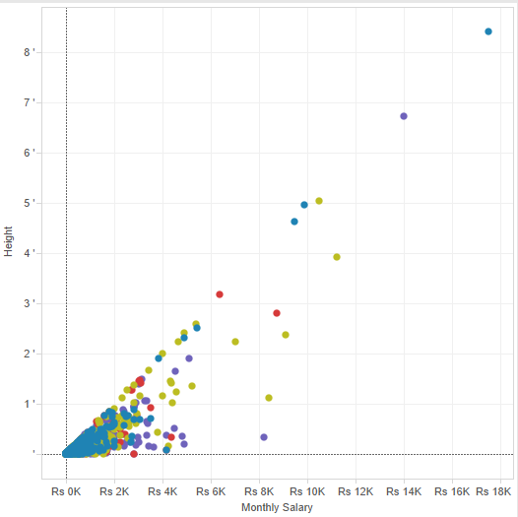

Scatter Plot

Slide 20
Choosing Charts based on Data Type
One Measure
Business Stories :
Distribution
Intervals
Grouping
Outliers
Categorize
Part to Whole –Intuitive
Range
Common Plots :
Histogram
Box Plot
Pie Chart
Notes:
By looking at this one measure chart,
we will be able to decide what can we do with this particular variable
Say like how can we group our data in such a way I can do my modelling efficiently.

Slide 21
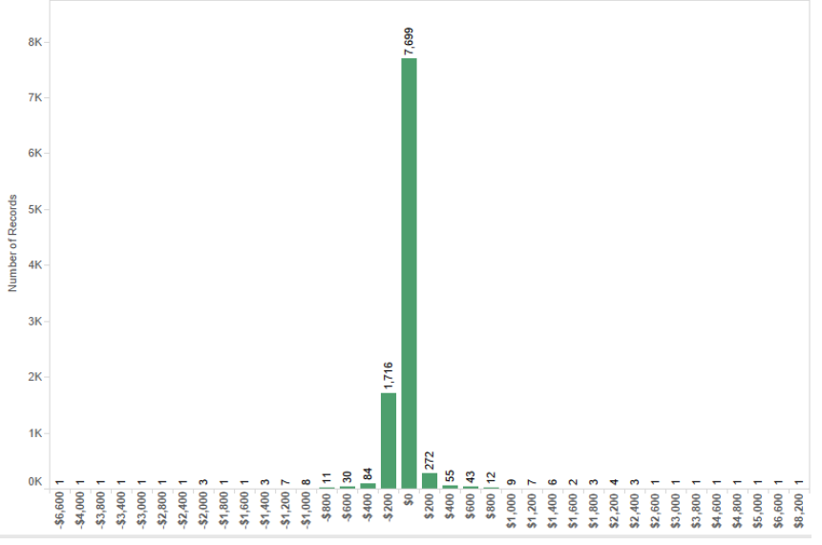
Histogram
Notes:
Benefits of a Histogram
Over time, histograms can show what the normal distribution is for a process that is running smoothly. However, by routinely producing histograms, any variation is quickly detected. This is a major advantage for organizations because it supports finding and dealing with process variation quickly.
A bell-shaped curve to the bar graph usually indicates normal distribution. Spikes in the graph indicate variation that should be addressed. Such spikes can also indicate opportunities to capitalize on a trend, as can be seen in the restaurant example below.

Slide 22
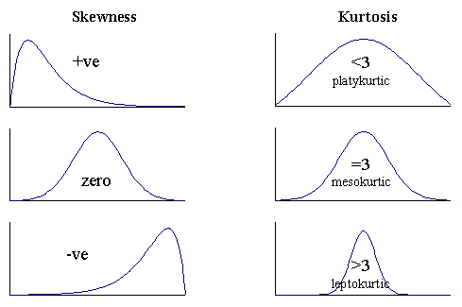
Histogram
Notes:
Benefits of a Histogram
Over time, histograms can show what the normal distribution is for a process that is running smoothly. However, by routinely producing histograms, any variation is quickly detected. This is a major advantage for organizations because it supports finding and dealing with process variation quickly.
A bell-shaped curve to the bar graph usually indicates normal distribution. Spikes in the graph indicate variation that should be addressed. Such spikes can also indicate opportunities to capitalize on a trend, as can be seen in the restaurant example below.

Slide 23
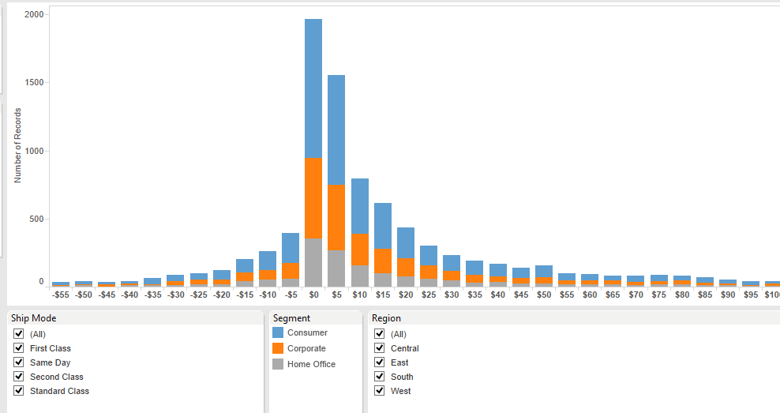
Histogram
Notes:
The main objective of a standard bar chart is to compare numeric values between levels of a categorical variable. One bar is plotted for each level of the categorical variable, each bar’s length indicating numeric value. A stacked bar chart also achieves this objective, but also targets a second goal.

Slide 24
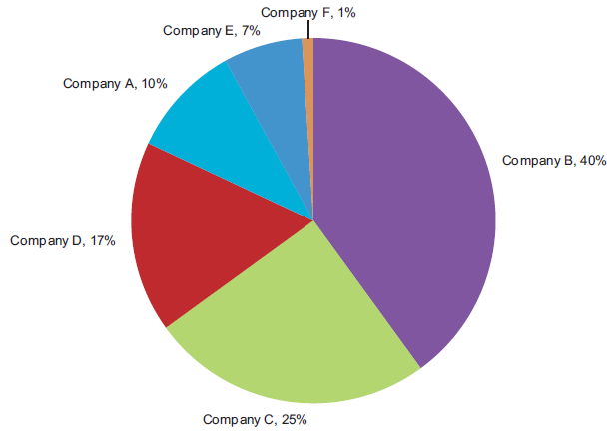
Pie Chart
Notes:
Consider you are doing a industry wide analysis.
You have taken companies that belong to see and are interested in seeing how companies share that specific industry market

Slide 25
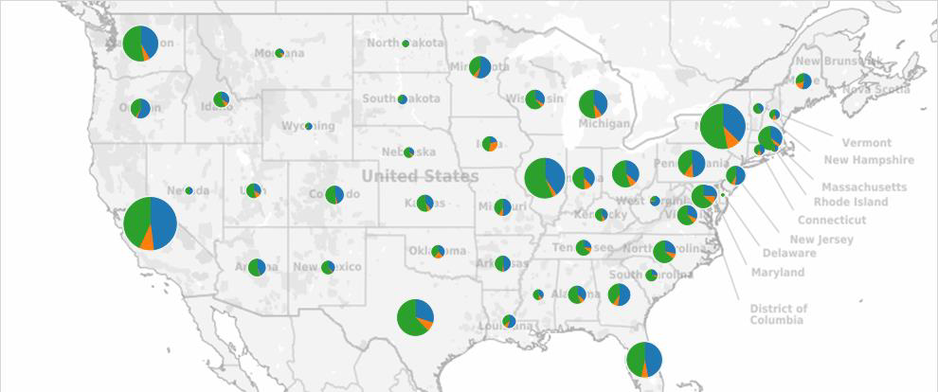
Pie Chart

Slide 26
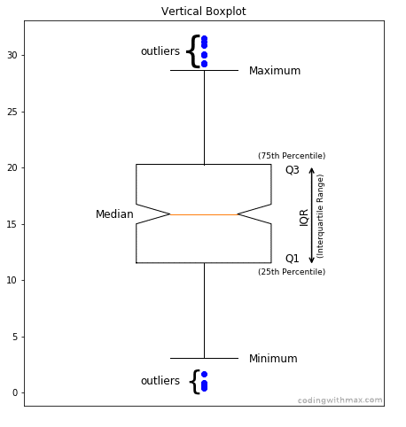
Box Plot (i.e. Box and Whisker Plot)
Mostly used for
•Distribution
•Range
•Outlier
•Large volumes of data
Notes:
https://math.stackexchange.com/questions/2491557/can-a-minimum-or-maximum-be-an-outlier

Slide 27
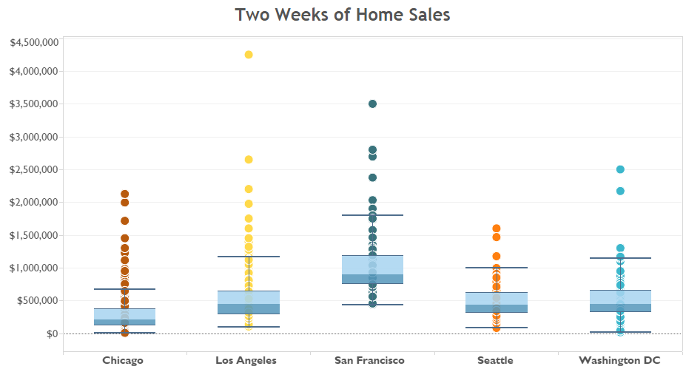
Box Plot
Notes:
https://math.stackexchange.com/questions/2491557/can-a-minimum-or-maximum-be-an-outlier

Slide 28
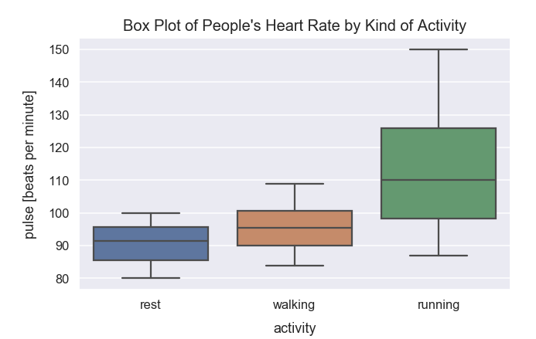
Box Plot
Notes:
https://math.stackexchange.com/questions/2491557/can-a-minimum-or-maximum-be-an-outlier

Slide 29
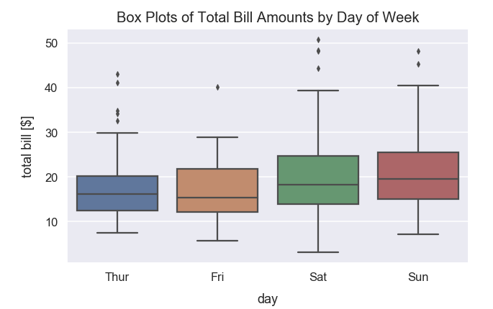
Box Plot
Notes:
https://math.stackexchange.com/questions/2491557/can-a-minimum-or-maximum-be-an-outlier

Slide 30
Choosing Charts based on Data Type
Date + One Measure
Business Stories :
Trend
Straightforward
Pattern
Sequence
Seasonality
Common Plots :
Lines

Slide 31
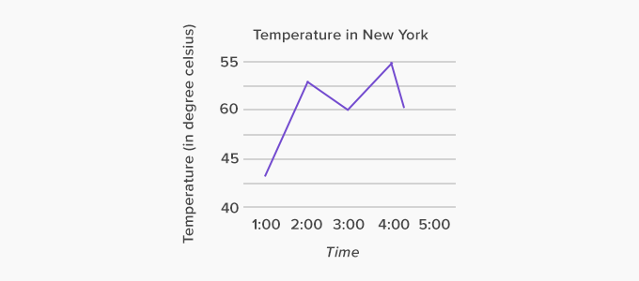
Line Graph
50
Notes:
We have data from 1 to 5PM
Because we have in Celsius, it should be during day
Temperature ranges from 41 to 55
High temperature recorded during this period is 55 during 4
Low temp recorded at 1 and it is 41

Slide 32
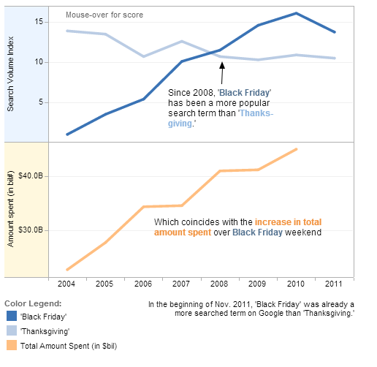
Stacked line graphs

Slide 33
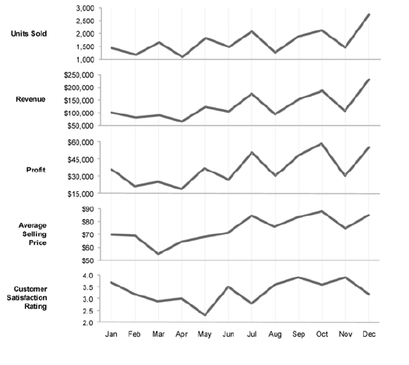
Stacked line graphs
Notes:
When you have more than one KPIs that change over time, this is hand in chart for that
This shows month on month trend of Units Sold over time. We shall inspect how Units solddrift

Slide 34
Choosing Charts based on Data Type
Two Measure + One Dimension
Business Stories :
Distribution
Hierarchy
Common Plots :
Tree Map

Slide 35
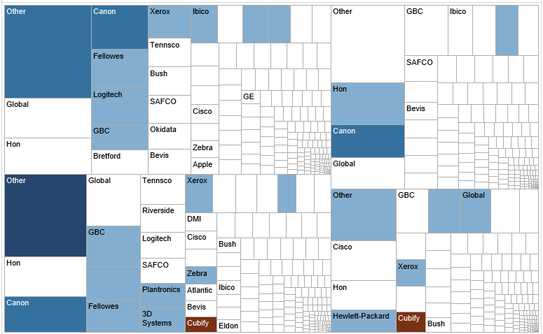

Tree Map

Slide 36
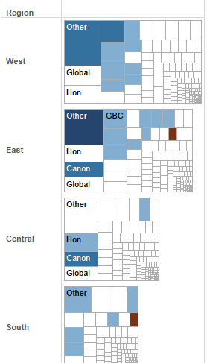
Tree Map

Slide 37
Python Libraries used for Data Visualization
Matplotlib
Seaborn
Plotly
Bokeh
Altair
Notes:
1. Matplotlib
Matplotlib is the most popular data visualization library of Python and is a 2D plotting library. It is the most widely-used library for plotting in the Python community and is more than a decade old. It comes with an interactive environment across platforms. Matplotlib can be used in Python scripts, the Python and IPython shells, the Jupyter notebook, web application servers and four graphical user interface toolkits. It is a very versatile visualization library. With this library, with just a few lines of code, one can generate plots, bar charts, histograms, power spectra, stem plots, scatterplots, error charts, pie charts and many other types.
2. Seaborn
The Python data visualization library of Seaborn is a library based on Matplotlib. It provides a much more terse API for creating KDE-based visualizations. It provides a high-level interface for drawing attractive and informative statistical graphics. It is tightly integrated with PyData stack, including support for numpy and pandas data structures. Seaborn aims to make visualization a central part of exploring and understanding data. Its dataset-oriented plotting functions operate on data frames and arrays containing whole datasets and internally perform the necessary semantic mapping and statistical aggregation to produce informative plots.
Seaborn and Matplotlib are two of Python's most powerful visualization libraries. Seaborn uses fewer syntax and has stunning default themes and Matplotlib is more easily customizable through accessing the classes.
3. Plotly
Plotly is a web-based toolkit to form data visualizations. Plotly can also be accessed from a Python Notebook and has a great API. With unique functionalities such as contour plots, dendrograms, and 3D charts, it has visualizations like scatter plots, line charts, bar charts, error bars, box plots, histograms, multiple axes, subplots and many others. It contains a great API including one for Python. It also has contour plots, something which is not very common in other libraries.
4 Bokeh is a Python library for creating interactive visualizations for modern web browsers. It helps you build beautiful graphics, ranging from simple plots to complex dashboards with streaming datasets. With Bokeh, you can create JavaScript-powered visualizations without writing any JavaScript yourself.
5 Altair
The Python library of Altair is a declarative statistical visualization library and has a simple API, is friendly and consistent and built on top of the powerful Vega-Lite visualization grammar. A declarative library needs one to only mention the links between the data columns to the encoding channels and the rest plotting is handled automatically. This elegant simplicity produces beautiful and effective visualizations with a minimal amount of code. The source of Altair is available on GitHub. It is easy to design effective and beautiful visualizations with a minimal amount of code using Altair.

Slide 38
Data Visualization Tools
Power BI
Tableau
Qlik
Notes:
Reference
Microsoft Power BI
It is a set of business analytics tools that can simplify data, prepare and analyze instantly. It is the most preferred tool as it can easily integrate with Microsoft tools and is absolutely free to use and download.
The tool is available for both mobile and desktop versions. So if a business uses Microsoft tools it can be a big benefit for them.
Key features of Microsoft Power BI:
Generate interactive data visualizations across multiple data centers
It offers enterprise data analytics as well as self-service on a single platform
Even non-data scientists can easily create machine learning models
2. Tableau
It is an interactive data visualization software. This tool is used for effective data analysis and data visualization in the industry. It has a drag and drop interface and this feature helps it to perform tasks easily and very fast.
The software doesn’t force its users to write codes. The software is compatible with a lot of data sources. The tool is a bit expensive but it is the most preferred choice of a top company like Amazon. Qlik view is the biggest competitor of tableau and the tool is extensively used because of its unique drag and drop feature.
Key features of Tableau:
Tableau is known as the simplest business intelligence tool for data visualization
Data scientists do not need to write custom code in this tool
The tool is also a real-time collaboration along with data mixing
3. QlikView
QlikView is a software similar to a tableau but you need to pay before using it for commercial purposes. It is a business intelligence platform that turns data into useful information.
This software helps to improve the data visualization process. The tool is preferred by well-established data scientists to analyze large scale data. Qlik view is used across 100 countries and has a very strong community.
Key features of QlikView:
The tool integrates with a very wide range of data sources such as EC2, Impala, HP Vertica, etc
It is extremely fast when it comes to data analysis
This data visualization tool is easily deployable as well as configurable

